Slide 1
Software Construction and Development
Capability Maturity Model Integration (CMMI)
Personal Software Process (PSP)
Team Software Process (TSP)
M Khizar Hayat
Email: Khizer.hayat@ucp.edu.pk
Office: Building D, 2nd Floor
OFFICE HOURS: Friday (9:00 to 11:00)

Slide 2
What is CMMI?
A process-level improvement model
Developed by Software Engineering Institute (SEI)
Helps organizations improve their processes
Used in software, hardware, and service development

Slide 3
Why Use CMMI?
Improve product quality
Reduce costs and risks
Increase customer satisfaction
Enable continuous process improvement

Slide 4
CMMI Models
CMMI for Development (CMMI-DEV)
CMMI for Services (CMMI-SVC)
CMMI for Acquisition (CMMI-ACQ)
Each focuses on specific business needs

Slide 5
Maturity Levels
Level 1 – Initial (chaotic)
Level 2 – Managed
Level 3 – Defined
Level 4 – Quantitatively Managed
Level 5 – Optimizing

Slide 6
CMMI Staged Representation - 5 Maturity Levels
Level 5
Process performance continually improved through incremental and innovative technological improvements.
Optimizing
Level 4
Quantitatively
Managed
Processes are controlled using statistical and other quantitative techniques.
Process Maturity
Level 3
Defined
Processes are well characterized and understood. Processes, standards, procedures, tools, etc. are defined at the organizational (Organization X ) level. Proactive.
Level 2
Managed
Processes are planned, documented, performed, monitored, and controlled at the project level. Often reactive.
Level 1
Initial
Processes are unpredictable, poorly controlled, reactive.

Slide 7
CMMI Level 1 – Initial
Unpredictable process
Success depends on individuals
Poor control and low efficiency

Slide 8
CMMI Level 2 – Managed
Basic project management practices
Track cost, schedule, and functionality
Still reactive, not proactive

Slide 9
CMMI Level 3 – Defined
Processes are well-documented
Organization-wide standards
More consistent and proactive

Slide 10
CMMI Level 4 – Quantitatively Managed
Use data and metrics to manage processes
Performance is measurable
Focus on predictability

Slide 11
CMMI Level 5 – Optimizing
Focus on continuous process improvement
Use feedback to innovate and optimize
Stable + flexible processes

Slide 12
Benefits of CMMI
Better process control
Higher customer satisfaction
Reduced defects and rework
Improved team productivity

Slide 13
CMMI along with scenario
Imagine you are part of a software company called SoftDevCo.The team is working on multiple projects.
You notice the following issues:
  Every project team follows its own way of writing code.
  Requirements are gathered but not documented.
  Testing is done only at the end of the project.
  Project delays are common, and quality is inconsistent.
  When team members leave, project knowledge is lost.
Your manager asks you to use CMMI and analyze what is our current maturity level, and what we should do to move to the next level?”

Slide 14
Solution
Current Maturity Level: Level 1 – Initial
  This organization is at CMMI Level 1 because:
  There are no standard processes followed.
  Work depends heavily on individual effort.
  Processes are unpredictable and reactive.
  There's no documentation or learning from previous projects.

Slide 15
Continued……..
Steps to Move to Level 2 – Managed:
To reach CMMI Level 2, SoftDevCo needs to:
Establish basic project management practices, like:
  Requirements gathering and documentation
  Project planning and tracking
  Basic configuration management
Create process guidelines to:
  Standardize how code is written
  Plan and document test cases earlier in the cycle
  Ensure knowledge is retained through documentation
Track performance metrics like:
  Delivery timelines
  Defect rates
  Team effort

Slide 16
The Personal Software Process (PSP)
The PSP process is designed for individual use.
To be most effective, engineers must plan their work.
To consistently improve their performance, engineers must personally use well-defined processes.
To produce quality products, engineers must feel personally responsible for the quality of their products.
It costs less to find and fix defects earlier in a process than later.
It is more efficient to prevent defects than to find and fix them.
The right way is always the fastest and cheapest way to do a job.

Slide 17
Overview of the PSP
A set of techniques to help engineers improve their performance through a step-by-step, disciplined approach to measuring and analyzing their work.
It provides detailed estimating and planning methods, shows engineers how to track their performance against these plans.
It shows software engineers how to apply advanced engineering methods to their daily tasks.
The PSP has been developed by the SEI to address the need for process improvement in small organizations and small project teams. This work can help to increase the effectiveness of individual engineers.
The Personal Software Process brings discipline to the practices of individual software engineers, dramatically improving the quality, predictability, and cycle time for software-intensive systems.

Slide 18
The PSP Evolution -1
The PSP process is enhanced through the following seven process versions.
  PSP0 and PSP0.1
  PSP1 and PSP1.1
  PSP2 and PSP2.1
  PSP3
Each level adds planning, estimation, reviews, and control.

Slide 19
PSP Overview
PSP3
Cyclic development
PSP2
Code reviews
Design reviews
PSP2.1
Design templates
PSP1.1
Task planning
Schedule planning
PSP1
Size estimating
Test report
PSP0.1
Coding standard
Size measurement
Process improvement
proposal (PIP)
PSP0
Current process
Time recording
Defect recording
Defect type standard

Slide 20
PSP - 0
The PSP0 process is a simple defined personal process.
In using PSP0, your principal objective is to gather and report accurate and complete data on your work.
PSP - 0.1
PSP0 is enhanced to PSP0.1 by adding a coding standard, size measurement, and the process improvement proposal (PIP).
The PIP is used to record process improvement ideas and is also used to record findings and comments on each project.
Program size is calculated before development, after development and to date.
Notes:
Where I m starting… where I am… that is psp..
Psp(0)… the initial stage.. Da na ye nu matlb u r not doing any thing…. U r not soft engineer.
Compile means to finalize the thing… or erorr free…..

Slide 21
PSP - 1
PSP1 adds size estimating and planning steps to PSP0.
LOC/hour (line of code per hour), size estimating calculations and actual size estimates are added to the Project plan summary.
PSP - 1.1
In PSP1.1, schedule planning(time managment) are introduced.
The PSP is extended to include resource estimating and schedule estimating.
Notes:
Estimation never accurate …..
Assignment :::: Line of code estimation mng sng kawaly sho..

Slide 22
PSP - 2
PSP2 adds code reviews and design reviews.
Design and code reviews effectively improve the quality of your programs and save development time.
PSP – 2.1
PSP 2.1 addresses the design process.
In PSP2.1, design completeness criteria are established and various design verification and consistency techniques are examined.
Another refinement at level 2.1 is the use of Design Templates for capturing the design in a systematic fashion.

Slide 23
PSP - 3
The cyclic PSP provides a framework for using a cyclic development strategy to develop large sized programs.
Used for larger systems
Incremental builds
Each cycle: Design → Code → Test

Slide 24
The benefits of the PSP -1
Significantly improve the estimating and planning ability of engineers while significantly reducing the defects in their products.
Provides you with an insight, to understand your strengths and weaknesses.
Gives you ideas to unconsciously observe your working self and will see many ways to improve your process and your performance.
Gives you an improvement techniques/processes as a defined process provides a language for thinking about your work
Gives you personal control, your plans will be more reliable. You will be better able to track your status and will be better able to manage your work.
The PSP process shows your accomplishments and personal bests. You will recognize your personal bests and will better understand how to repeat them.
You will see where and how you have improved.

Slide 25
When to use / When to avoid using the PSP
Use when:
  You want disciplined improvement
  Organization supports process
Avoid when:
  No management/peer support

Slide 26
Team Software Process (TSP)
  • Team-level extension of PSP
  • Requires PSP-trained engineers
  • Structured teamwork framework

Slide 27
The Conditions for Teamwork
A team consists of at least two people.
The members are working toward a common goal.
Each person has a specific assigned role.
Completion of the mission requires some form of dependency among the group members

Slide 28
Characteristics of Effective Teams
• Skilled members
• Clear goals
• Discipline
• Cooperation
• Motivation

Slide 29
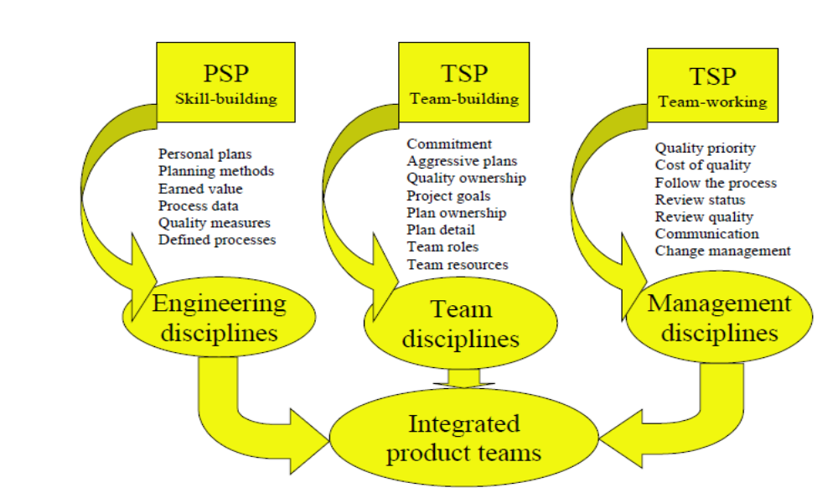
TSP Structure

Slide 30
TSP Development Cycle
There are the following three phases in the TSP development cycle:
Launch Phase | Execution Phase | Post-Mortem Phase
• Establish goals • Define roles • Estimate effort • Create team plan | • Track schedule & defects • Weekly meetings • Adjust plan if needed | • Analyze performance • Compare planned vs actual • Capture lessons learned

